Slide 1

Licence Plate Recogniser
User Manual
Author: Pranjal Bhatia
Notes:
Preworks course home assignments

Slide 2
Table of Contents
Slide Number | Slide Title
3 | Acknowledgements
4 | About Me
5 | About My Internship Journey
6 | About App
7 | Instruction to Use APP
8 | Demo Video
9 | Toolkit Walkthrough
10 | Contact Point

Slide 3
Acknowledgements
I would like to express my heartfelt gratitude to everyone who has supported me throughout the journey of app development. Special thanks to my parents for their unwavering encouragement, my mentors, especially Dr. Ken Khan, for their invaluable guidance, and my group members and friends for their collaboration and support. I also appreciate the various online resources that provided essential information. Thank you all for being part of this journey.

Slide 4
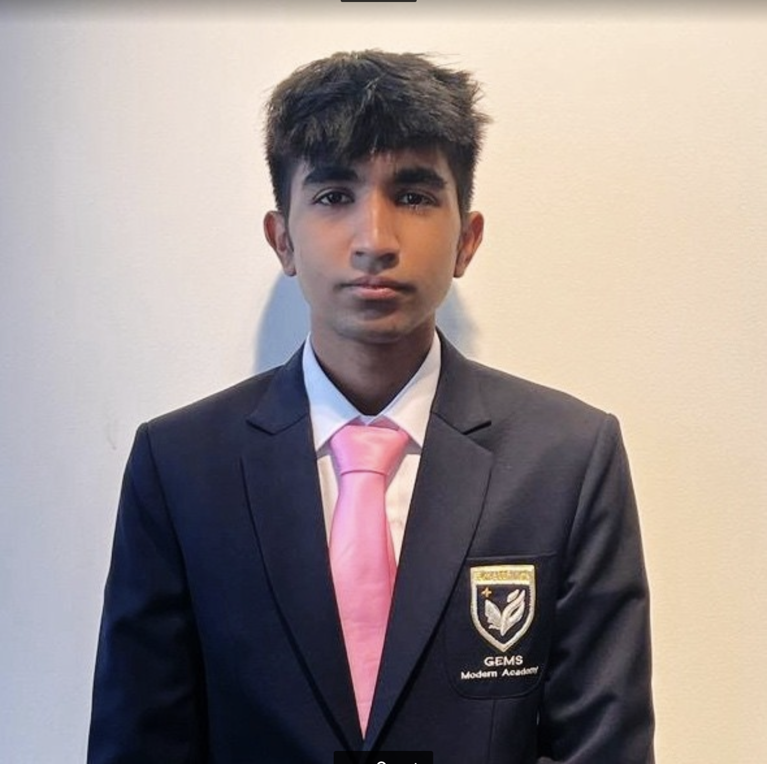
About Me..
Student’s Photograph
Student’s Introduction
I am Pranjal Bhatia. I am from Delhi. I am in the 12th Grade, studying Robotics and Maths. In the future I aim to be working in motorsports and ideally formula 1, hence I plan on pursuing a degree in Mechanical Engineering and Data Science to achieve the same

Slide 5
About My Internship Journey with Clevered..
During my internship at Clevered, I had the incredible opportunity to work on a fascinating project focused on Car Name Plate Detection using computer vision. This project required me to utilize various libraries such as OpenCV and PyTesseract to detect license plates from car images, which significantly enhanced my technical skills in data science and machine learning.
The project involved several steps, from image processing and contour detection to text recognition. The detailed project steps and resources, including online tutorials and installation guides, were immensely helpful in guiding my work.
Throughout this journey, the support and guidance from my teachers and mentors were invaluable. They not only facilitated my learning process but also nurtured my growing interest in data science and machine learning. Their expertise and encouragement helped me navigate the complexities of the project and achieve successful outcomes.

Slide 6
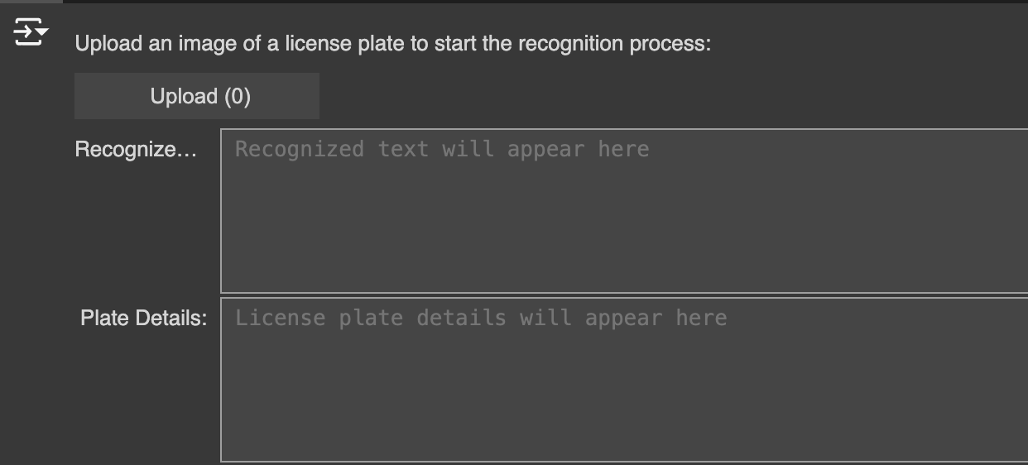
About App..
App’s Main Menu

Slide 7
How do I use the App?

Slide 8
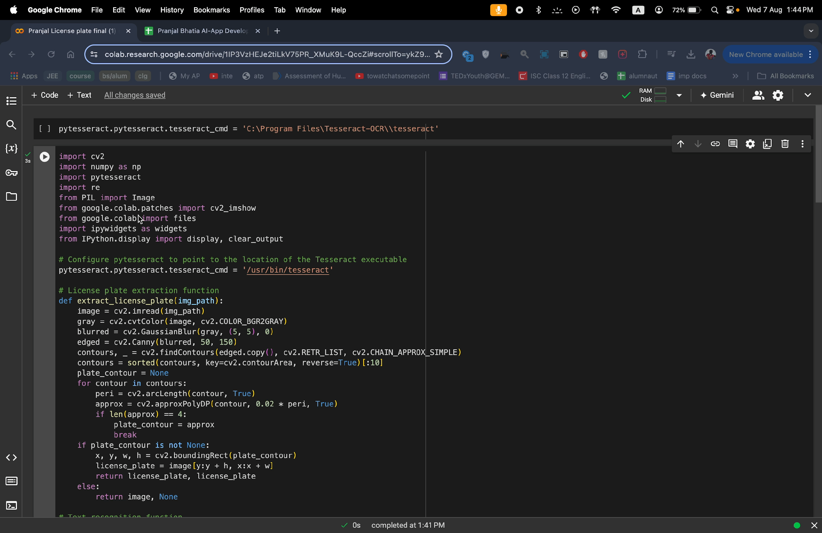
Demo Video

Slide 9
Toolkit Walkthrough
App Develop ToolKit Workbook: https://docs.google.com/spreadsheets/d/1ymR47_SzdSMmuqWPeGR2jiGHDyz0w2-m/edit?gid=765955134#gid=765955134
Linkedin:
Discord :

Slide 10
Contact Person
Please reach out to me for any questions/ concerns/ suggestions on the App
Email : pranjal.bhatia710@gmail.com
Linkedin: https://www.linkedin.com/in/pranjal-bhatia-8b06232a2/

Slide 11
Thank you!

